Slide 1
International Conclave on Foundations of Decision and Game Theory IGIDR, Mumbai March 14-19, 2016
STATUS CLASSIFICATION USING NETWORK
Manjari Das† Ritwika Law♣
† Indian Statistical Institute, Kolkata
♣ Calcutta University

Slide 2
Objective
A person's social behaviour influences living style and decisions in life.
To find : social behaviour can determine a person's loan repaying capability?
need a way to interpret the social behaviour of a person from visible (network and background) traits?

Slide 3
Objective(contd)

Slide 4
Data Description
Source of data : https://snap.stanford.edu/data
Social networking site : Google plus
number of subjects : 1692
1319 records for each subject. Value is '0' or '1’.
First column of data contains subjects' names
Attribute information
columns 2 to 4 correspond to gender
columns 4 to 122 correspond to institution
columns 811 to 1177 correspond to place
columns 1178 to 1319 correspond to university

Slide 5
Classification
Gender
Male
Female
Others
Institution
Research and education
Finance
Self-employed
IT engineering
Media( News, Entertainment)
Others
University
America
Asia
Europe
Others
Place
America
Asia
Europe
Others

Slide 6
Algorithm for data modification
Given : i) A file (say binfile) containing the id numbers of n different person and a binary string of 0’s and 1’s for each possible position of each id.
ii) A file (say featname) containing the list of all the feature names of n different person
Steps
Step 1: set I :=0
Step 2: find the positions of 1’s in the binary string of 0’s and 1’s of the ith id stored in the file binfile and store the positions in a new file (say file1) along with the id.
Step 3: set i :=i + 1
Step 4: if i<n goto step 2 else goto step 5

Slide 7
Algorithm for data modification(contd)
Step 5: set i :=0
Step 6: extract the string containing the position of 1’s for the ith id from file1 file
Step 7: search the features stored in a file named featnames of the person having the ith id by the position numbers extracted from file file1 and store them in a file (say file2) along with the id number
Step 8: set i :=i + 1
Step 9: if i<n then goto step 6 else goto step 10
Step 10: the new file generated (file2) contains the details of n different persons
Step 11: end

Slide 8
Example of the modification on first subject
Original record :
114985346359714431656 1 0 0 0 0 0 0 0 0 0 0 0 0 0 0 0 0 0 0 0 0 0 0 0 0 0 0 0 0 0 0 0 0 0 0 0 0 0 0 0 0 0 0 0 0 0 0 0 0 0 0 0 0 0 0 0 0 0 0 0 0 0 0 0 0 0 0 0 0 0 0 0 0 0 0 0 0 0 0 0 0 0 0 0 0 0 0 0 0 0 0 0 0 0 0 0 0 0 0 0 0 0 0 0 0 0 0 0 0 0 0 0 0 0 0 0 0 0 0 0 0 0 0 0 0 0 0 0 0 0 0 0 1 0 0 0 0 0 0 0 0 0 0 0 0 0 0 0 0 0 0 0 0 1 1 0 0 0 0 0 0 0 0 0 0 0 0 0 0 0 0 0 0 0 0 1 0 0 0 0 0 0 0 0 0 0 0 0 0 0 0 0 0 0 0 0 0 0 0 0 0 0 0 0 0 0 0 0 0 0 0 0 0 0 0 0 0 0 0 0 0 0 0 0 0 0 0 0 0 0 0 0 0 0 0 0 0 0 0 0 0 0 0 0 0 0 0 0 0 0 0 0 0 0 0 0 0 0 0 0 0 0 0 1 0 0 1 0 1 0 0 0 0 0 0 0 0 0 0 0 0 0 0 0 0 0 0 0 0 0 0 0 0 0 0 0 0 0 0 0 0 0 0 0 0 0 0 0 0 0 0 0 0 0 0 0 0 1 0 1 0 0 0 0 0 0 0 0 0 0 0 0 1 0 0 0 0 0 0 0 0 0 0 0 1 0 0 0 0 0 0 0 0 0 0 0 0 0 0 0 0 0 0 0 0 0 0 0 0 0 1 0 0 0 0 0 0 0 0 0 0 1 1 0 0 0 0 0 0 0 0 0 0 0 0 1 0 0 1 0 0 0 0 0 0 0 0 0 0 0 0 0 0 0 0 0 0 0 1 0 0 0 0 0 0 0 0 0 0 0 0 0 0 0 0 0 0 0 0 0 0 0 0 0 0 0 0 0 0 0 0 0 0 0 0 0 0 0 0 0 0 0 0 0 0 0 0 0 0 0 0 0 1 0 0 0 0 0 0 0 0 0 0 0 0 0 0 0 0 0 0 0 0 0 0 0 0 0 0 0 0 0 0 0 0 1 0 0 0 0 0 0 0 0 0 0 0 0 0 0 0 0 0 0 0 0 0 0 0 0 0 0 0 0 0 0 0 0 0 0 0 0 0 0 0 0 0 0 0 0 0 0 0 0 1 0 0 1 0 0 0 0 0 0 0 0 0 0 0 0 0 0 0 1 0 0 0 0 0 0 0 0 0 0 0 0 0 0 0 1 0 0 0 0 0 0 0 0 0 0 1 0 0 0 0 0 0 0 0 0 0 0 0 0 0 0 0 0 0 0 1 0 0 0 0 0 0 0 0 0 0 0 0 0 0 0 0 0 0 0 0 0 0 0 0 0 0 0 0 0 0 0 0 0 0 0 0 0 0 0 0 0 0 0 0 0 0 0 0 0 0 0 0 0 0 0 0 0 0 0 0 0 0 0 0 0 0 0 0 0 0 0 0 0 0 0 0 0 0 0 0 0 0 0 0 0 0 0 0 0 0 0 0 0 0 0 0 0 0 0 0 0 0 0 0 0 0 0 0 0 0 0 0 0 0 0 0 0 0 0 0 0 0 0 0 0 0 0 0 0 0 0 0 0 0 0 0 0 0 0 0 0 0 0 0 0 0 0 0 0 0 0 0 0 0 0 0 0 0 0 0 0 0 0 0 0 0 0 0 0 0 0 0 0 0 0 0 0 0 0 0 0 0 0 0 0 0 0 0 0 0 0 0 0 0 0 0 0 0 0 0 0 0 0 0 0 0 0 0 0 0 0 0 0 0 0 0 0 0 0 0 0 0 0 0 0 0 0 0 0 0 0 0 0 0 0 0 0 0 0 0 0 0 0 0 0 0 0 0 0 0 0 0 0 0 0 0 0 0 0 0 0 0 0 0 0 0 0 0 0 0 0 0 0 0 0 0 0 0 0 0 0 0 0 0 0 0 0 0 0 0 0 0 0 0 0 0 0 0 0 0 0 0 0 0 0 0 0 0 0 0 0 0 0 0 0 0 0 0 0 0 0 0 0 0 0 0 0 0 0 0 0 0 0 0 0 0 0 0 0 0 0 0 0 0 0 0 0 0 0 0 0 0 0 0 0 0 0 0 0 0 0 0 0 0 0 0 0 0 0 0 0 0 0 0 0 0 0 0 0 0 0 0 0 0 0 0 0 0 0 0 0 0 0 0 0 0 0 0 0 0 0 0 0 0 0 0 0 0 0 0 0 0 0 0 0 0 0 0 0 0 0 0 0 0 0 0 0 0 0 0 0 0 0 0 0 0 0 0 0 0 0 0 0 0 0 0 0 0 0 0 0 0 0 0 0 0 0 0 0 0 0 0 0 0 0 0 0 0 0 0 0 0 0 0 0 0 0 0 0 0 0 0 0 0 0 0 0 0 0 0 0 0 0 0 0 0 0 0 0 0 0 0 0 0 0 0 0 0 0 0 0 0 0 0 0 0 0 0 0 0 0 0 0 0 0 0 0 0 0 0 0 0 0 0 0 0 0 0 0 0 0 0 0 0 0 0 0 0 0 0 0 0 0 0 0 0 0 0 0 0 0 0 0 0 0 0 0 0 0 0 0 0 0 0 0 0 0 0 0 0 0 0 0 0 0 0 0 0 0 0 0 0 0 0 0 0 0 0 0 0 0 0 0 0 0 0 0 0 0 0 0 0 0 0 0 0 0 0 0 0 0 0 0 0 0 0 0 0 0 0 0 0 0 0 0 0 0 0 0 0 0 0 0 0 0 0 0 0 0 0 0 0 0 0 0 0 0 0 0 0 0 0 0 0 0 0 0 0 0 0 0 0 0 0 0 0 0 0 0 0 0 0 0 0 0 0 0 0 0 0 0 0 0 0 0 0 0 0
After modification :
114985346359714431656 0 132 153 154 175 263 266 268 317 319 332 344 370 381 382 395 398 418 472 505 554 557 573 589 600 620

Slide 9
Distance formulation
For two persons (x_{i0}, x_{i1}, x_{i2}, x_{i3}, ..., x_{ip}) is their information vector for i = 1 , 2.
d = ∑|x_{1j} – x_{2j}|w_{j} is the distance between person 1 and person 2.
d = ∑|x_{1j} – x_{2j}|w_{j} + (v-m)w_{p+1}, where v is the total number of persons and m is the number of mutual friends of person 1 and person 2.

Slide 10
Distance Metric
gender | male | female | others
male | 0 | 1 | 2
female | 1 | 0 | 2
others | 2 | 2 | 0
Place | America | Europe | Asia | Others
America | 0 | 1 | 2 | 3
Europe | 1 | 0 | 1 | 2
Asia | 2 | 1 | 0 | 2
Others | 3 | 2 | 2 | 0

Slide 11
University | America | Europe | Asia | Others
America | 0 | 1 | 2 | 3
Europe | 1 | 0 | 1 | 2
Asia | 2 | 1 | 0 | 2
Others | 3 | 2 | 2 | 0
Institution | Research | Finance | Self Employed | IT Engineering | Media | Others
Research | 0 | 1 | 1 | 1 | 1 | 1
Finance | 1 | 0 | 1 | 1 | 1 | 1
Self Employed | 1 | 1 | 0 | 1 | 1 | 1
IT, engineering | 1 | 1 | 1 | 0 | 1 | 1
Media | 1 | 1 | 1 | 1 | 0 | 1
Others | 1 | 1 | 1 | 1 | 1 | 0

Slide 12
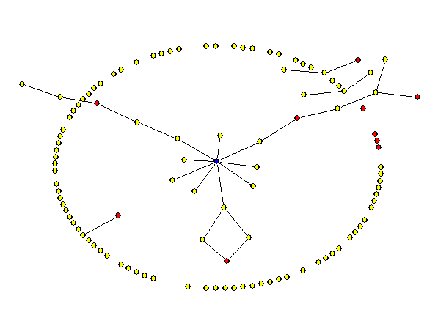
Distance – Probability MLE
We add an extra column in the distance file by using the edge file, which contains 1 or 0 according to whether the pair is connected or disconnected.
The equation is P(pair (i, j) is joined)=p⁰e^{-ad}, where d is the distance between user i and user j and p⁰ is the probability of connecting a pair with distance 0 and a is constant to be estimated.

Slide 13
Distance – Probability MLE(contd)
The likelihood equation is as follows
Next we use the distance data to calculate the maximizer of the parameters.

Slide 14
Degree Distribution for the current data set
percentile | degree
10% | 15.9
20% | 45
30% | 71
40% | 98
50% | 142
60% | 192
70% | 232
80% | 328.2
90% | 496.1
100% | 1084

Slide 15
Degree Distribution for the current data set(CONTD)

Slide 16
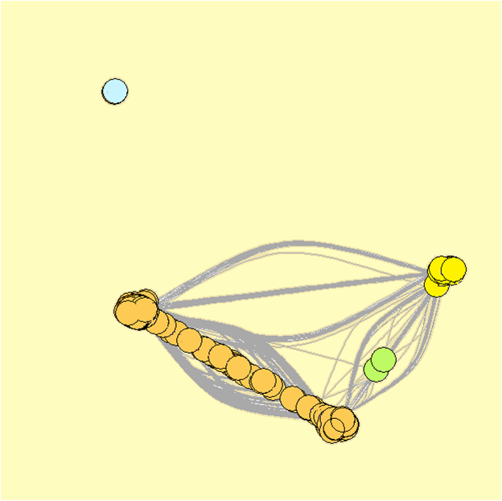
Degree Distribution for the current data set(CONTD)

Slide 17
Simulation
Simulation
E is the graph (V, É), where V is the set of persons(vertices) and É is the set of edges(connectedness)
Pick up E_{l}ª is a subset of E, SRSWOR for a = 20%, 40%, 60%, 80% , l = 1 (1) 10 each.
For, each E_{l}ª, generate chain { E_{l}ª (0), E_{l}ª (1), E_{l}ª (2), …, E_{l}ª (4)=Ê_{l}ª }, with p_{ij}=P(d_{ij}) rule. If we are at E_{l}ª (k), for each pair (i,j), we connect them with probability p_{ij} to get E_{l}ª (k+1),

Slide 18
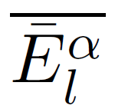
Distance Formulation and Simulation(contd)
Repeat (2) 200 times to create {Ê_{l}ª (1), . . . , Ê_{l}ª (200)} which are iid copies.
Take average
This gives an empirical estimate of ((P_{ij})), the probability matrix generating E.
Study statistical proximity between E and for all a and for all l.

Slide 19
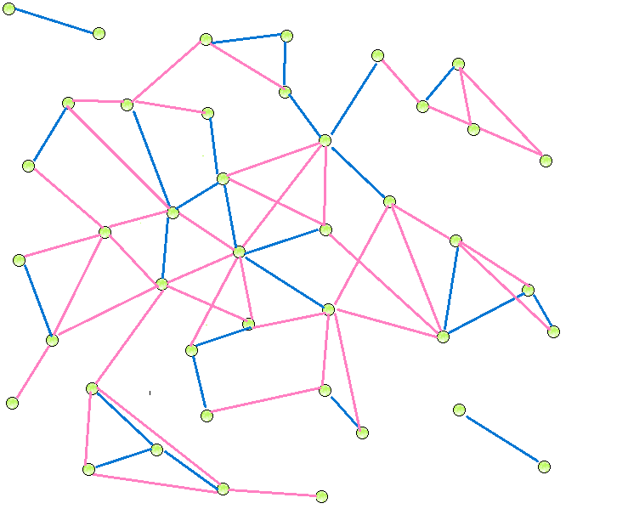
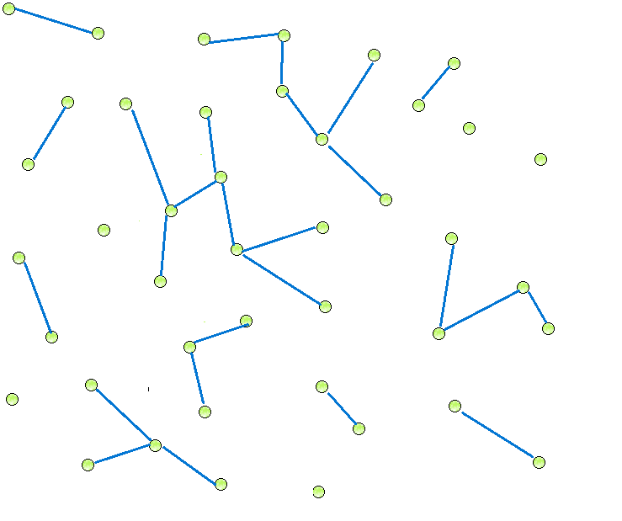
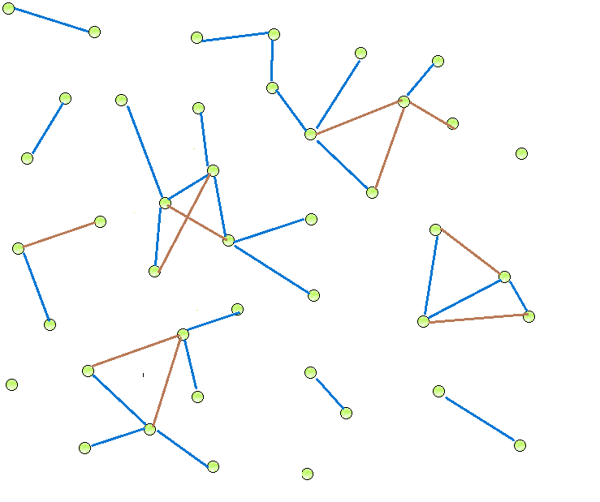

Slide 20
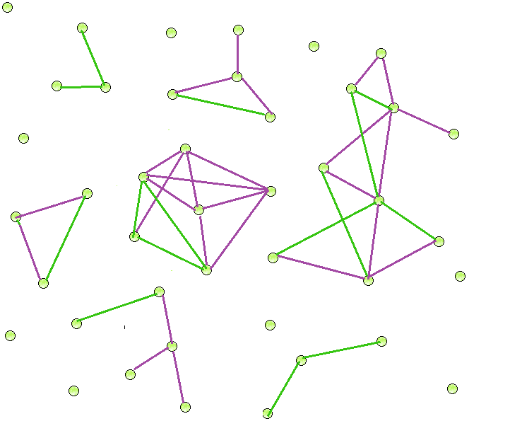
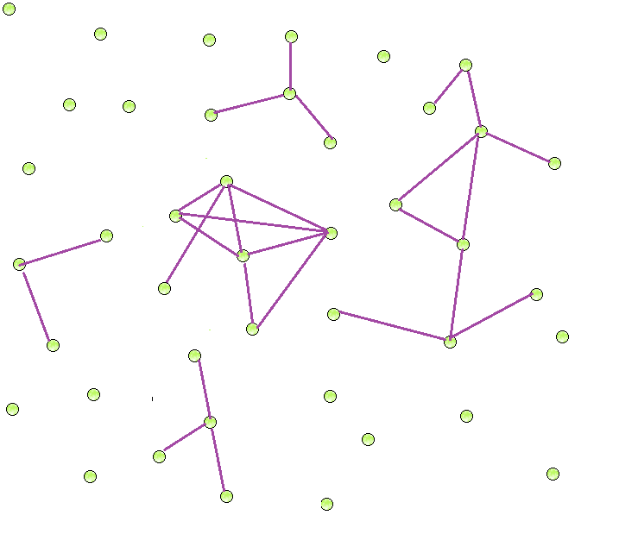
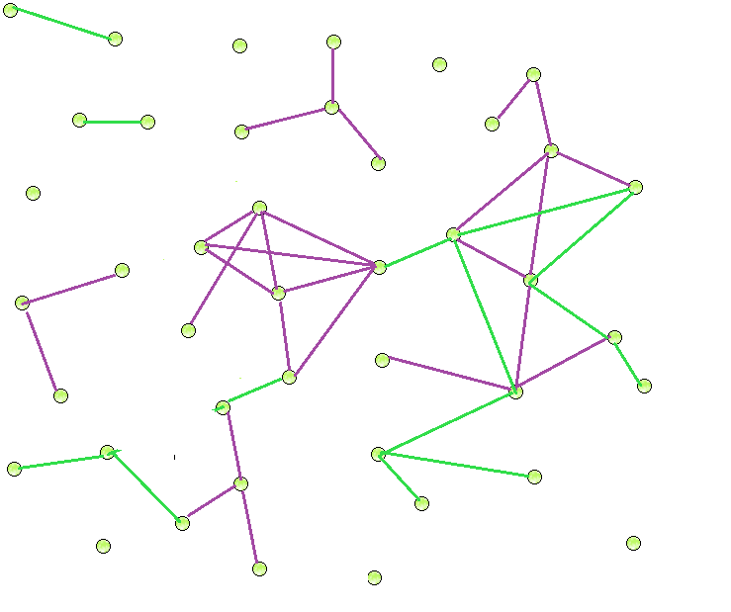
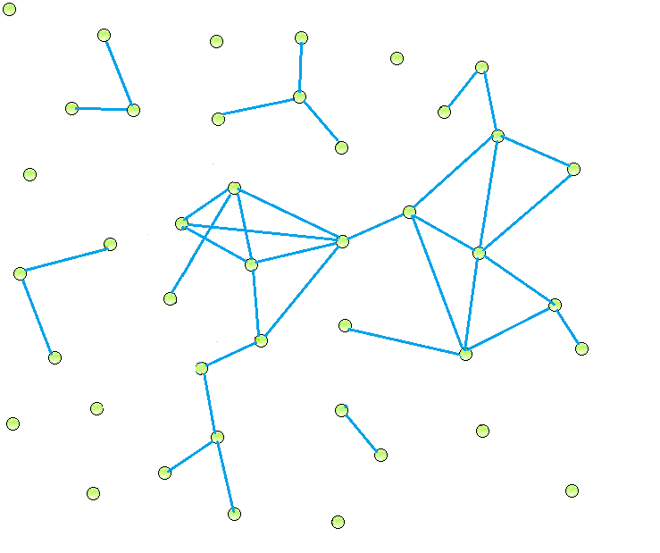
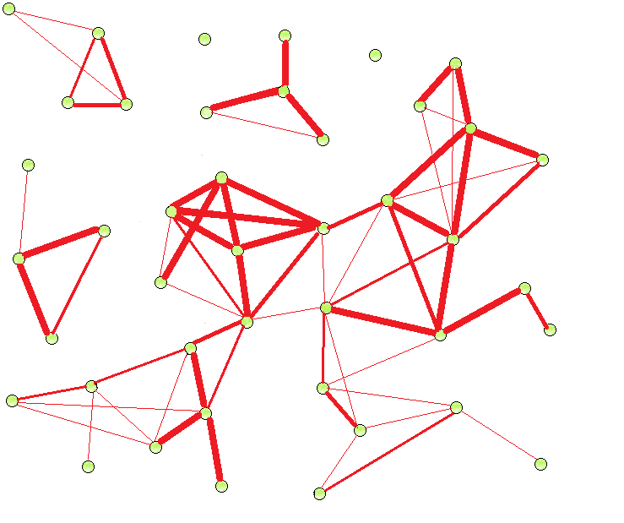
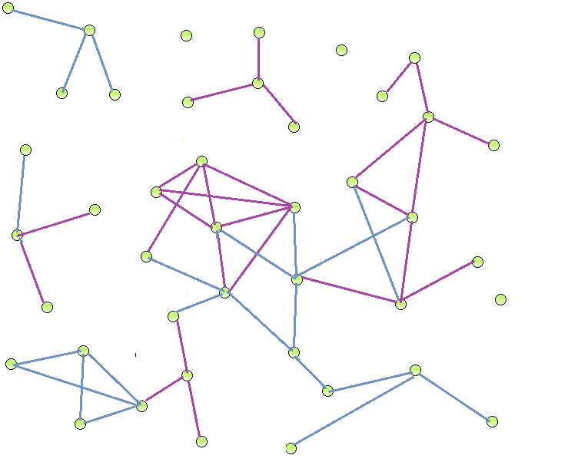
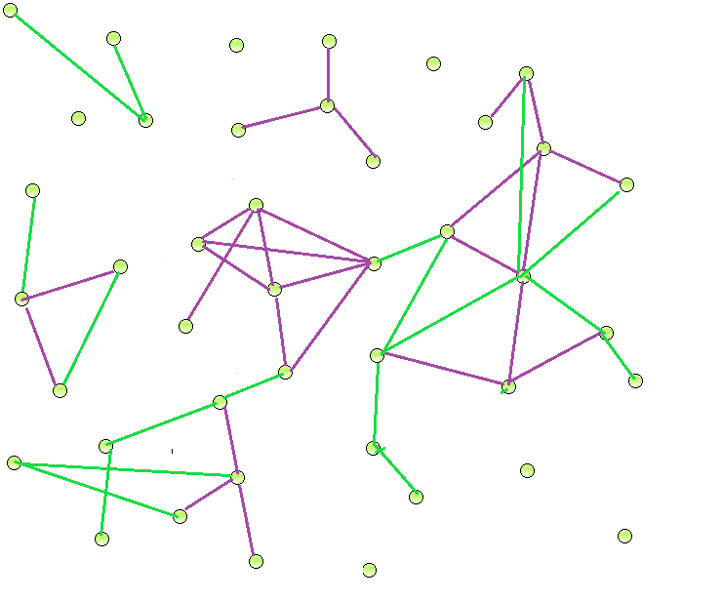
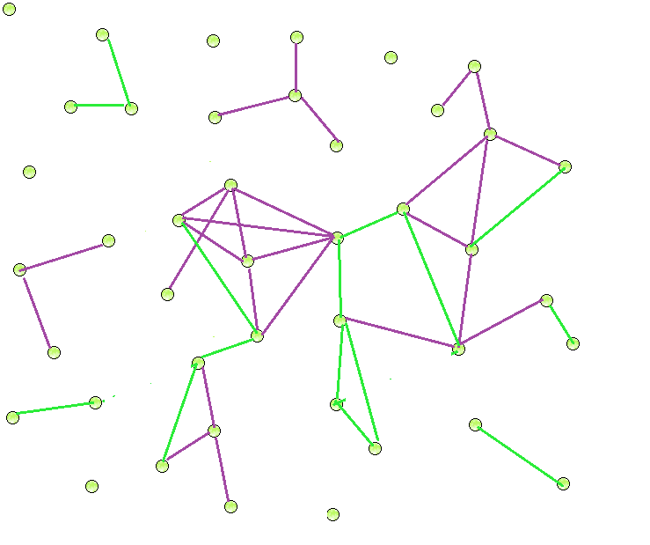

Slide 21
Calculation of number of mismatches
Choose 60% of the pairs from the edge set file.
Complement of the edgeset file + 40% of the pairs from the edgeset file are unconnected now.
Now we will try to connect these pairs using a probability function which depends on the distance files (say P(d)).
Calculate P(d_{ij}) for each unconnected pair
id_{i} id_{j} P(d_{ij}) [0≤P(d_{ij})≤1]

Slide 22
Calculation of number of Mismatches(contd)
Generate a random number for each unconnected pair( say r). If r ≤P(d_{ij}) then create an edge else take another unconnected pair and repeat step 3.
The resultant file will contain the pairs which are connected using P(d)
(filename add edge) for connected pairs.

Slide 23
Calculation of number of mismatches(contd)
Filename outside(= ^{n}C₂ -edgefile)
Filename delete_edge(=40% pairs deleted in step 2)
Calculate number of mis-matches = [outside∩add_edge] + [deleted_edge –add_edge∩deleted_edge]
Repeat from step 2 and calculate the number of mismatches.
Take 10 sets of mismatches

Slide 24
Calculation of number of mismatches(contd)
<add_edge>
= <add_edge>∩<outside> + <add_edge>∩<deleted_edge>
<add_edge>∩<outside>
= <add_edge> - <add_edge>∩<deleted_edge>
mismatch
= <add_edge> - 2 <add_edge>∩<deleted_edge> + <deleted_edge>

Slide 25
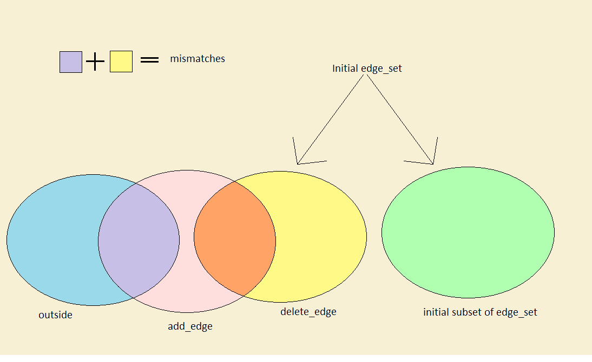
Calculation of number of Mismatches(contd)

Slide 26
Program Output
Programming language used : Dev C++
Number of possible pairings considered : 10700
Initial edges : 485
Number of iterations : 4
Maximum Likelihood estimates : p⁰ = 0.103, a=0.65

Slide 27
Distribution of errors for 20% subsample

Slide 28
Distribution of errors for 40% subsample

Slide 29
Distribution of errors for 60% subsample

Slide 30
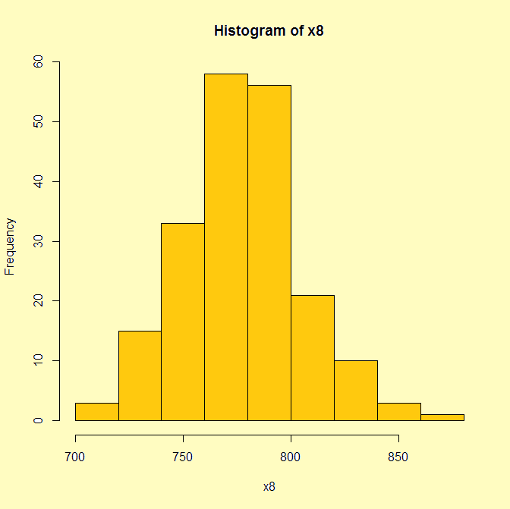
Distribution of errors for 80% subsample

Slide 31
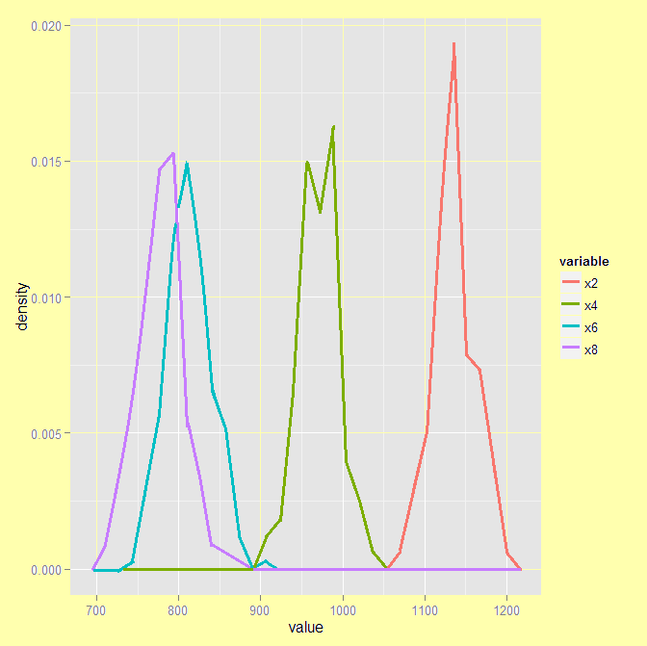
Distribution of error

Slide 32
Application Areas
Loan : A bank can decide whether to lend loan to a customer and how much to loan by considering the performance of his acquaintances in loan repaying capability.
Admission students by Universities
Employment of job applicants by companies
Insurance : Similar method can be used here.

Slide 33
Application(contd)
In the dataset we are using we have very limited information about the subjects. The only change in the distance between two individuals is the number of mutual friends. If we instead had facebook data or twitter data where we also can see the subjects’ interests and likes, the influence could have been studied in a more detailed manner.

Slide 34
References
Evolution of Social-Attribute Networks: Measurements, Modelling, and Implications using Google+ by Neil Zhengiang, Wenchang Xu, Ling Huang, Prateek Mittal, Emil Stefanov, Vyas Sekar and Dawn Song.
Jointly Predicting Links and Inferring Attributes using a Social-Attribute Network (SAN) by Dawn Song, Ling Huang, Neil Zhengiang Gong, Ameet Talwalkar, Lester Mackey, Eui Chul Richard Shin, Emil Stefanov and Elaine (Runting) Shi.
Impact of Social Network on Financial Decision, forthcoming in Studies in Microeconomics 2015 by Koushiki Sarkar, Abhishek Ray and Diganta Mukherjee.
Algorithm Design by John Kleinberg and Eva Tardos.

Slide 35
Thank You

